Slide 1


SAP UI5 & FIORI with OData TRAINING using BAS
Anubhav Oberoy
Day – 9

Slide 2

Agenda – Day 9
User Experience V/S User Interface
UI5 vs Fiori
What is Fiori?
Structure of Fiori App
Introduction to Component.js File

Slide 3
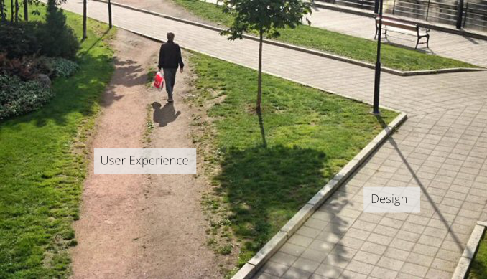
User Experience v/s User Interface
UI stands for user interface but UX stands for User Experience
UI is technical view point of our application interface which will be used to take and provide information to the user but UX is psychological and emotions of the app.
We can change the UI but we cannot change UX
Take an example of modern world of apps, where no one needs to give you training to use amazon, uber, eBay etc.
User interface is developer oriented. This is purely technical. We can change UI any number of times.
User experience is user oriented. It is psychological. We cannot change UX.

Slide 4
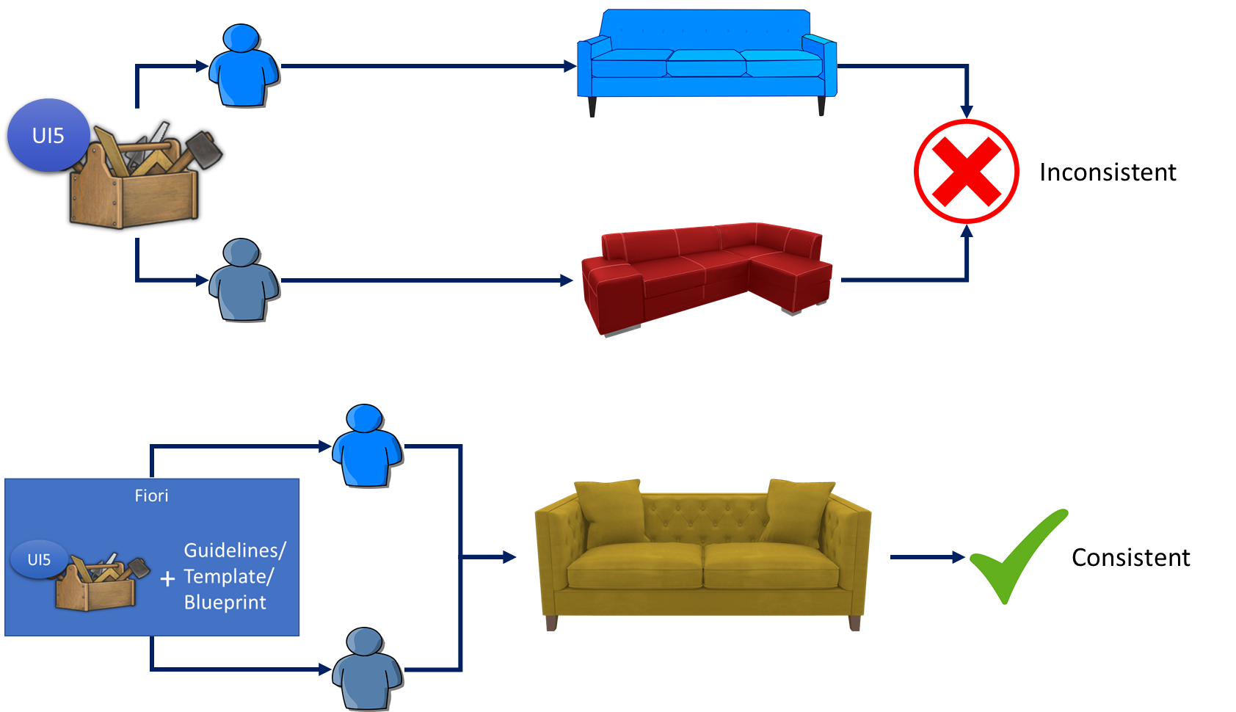
UI5 V/S Fiori
SAPUI5 is used to design UI but SAP Fiori is used to create User experience. Fiori apps are technically built on SAP UI5 only but they follow guidelines which are provided by sap and proven golden path for development of apps.
SAP Fiori provides also the pre-defined templates like master details, object list page, worklist etc. which brings our UI more closer to User experience.

Slide 5
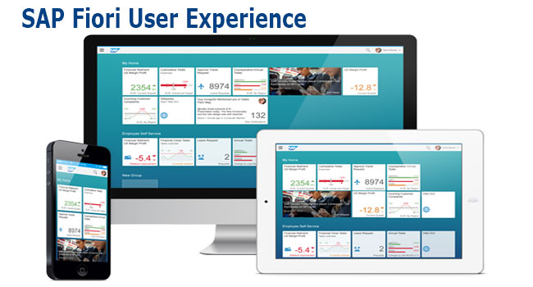
What is Fiori?
SAP Fiori is the user interface or user experience (UX) that supplements and can replace the SAP GUI. This streamlined application uses tiles to encapsulate standard tasks, such as approving purchase requisitions, viewing sales orders, and approving timesheets.
Fiori is SAP’s new user experience. These are standard apps delivered by SAP and by following the Development guidelines any one can use UI5 to create Fiori Apps.
Fiori is a streamlined application, delivering a role-based user experience that can be personalized across all lines of business, tasks and devices.
It uses tiles to encapsulate standard tasks like viewing sales orders or approving timesheets.
Fiori = UI5 + Development/Design Guidelines

Slide 6
Structure of a Fiori App
There are different folders and directory are required for setup project: webapp, Controller, models, utils ,view, Component.js, manifest.json, index.html
Structure of normal ui5 application
Index.html
View
Controller
Structure of Fiori Application
Dev.
sap/ui/core/UIComponent
Index.html
Root View
App.view.xml
Component.js
View 1
Controller 1
Container
App (pages)
View 2
Controller 2
manifest.json
App descriptor
App.controller.js
BaseController
Component.js is starting point

Slide 7
Component.js File
Component.js the starting point of all Fiori applications, it is used by Fiori Launchpad to kick-start our app. If an app has Component.js inside, it called Fiori like app.
We will decouple everything from index.html to avoid user starring app w/o launchpad because of security rick of user opening app direct from index file.
It is the wrapper of all the functionality.
The name of the file must be, must be Component.js
It should ideally be created inside the webapp folder
If our app does not have Component.js, we will not be able to integrate our app with launchpad
It is a class which inherits from sap/ui/core/UIComponent standard class. We inherit to reuse the functionality offered by SAP like routing.
When app starts, UI5 framework will scan your project’s base directory to check if it has a file with exact name Component.js
The component file calls the manifest file, and we keep all app level configuration inside the manifest file.

Slide 8
Title
Content

Slide 9
Title
Content

Slide 10
Title
Content

Slide 11
Title
Content

Slide 12
Title
Content

Slide 13
Title
Content

Slide 14
Title
Content

Slide 15

End of Day 9

Slide 16

Questions

Slide 17

Anubhav Oberoy

Slide 18


We’re committed to empower you to be
Most Desirable Resource
through powerful training solutions.
We build the workforce of the future.
250+
Corporate Clients
30,000+
Learners Trained
25000+
Learners Placed
FREE WEBINARS
Sign up for free webinars with industry experts every fortnight!
Enroll Now!
Contact us today!
https://anubhavtrainings.com/

Slide 19




More from AnubhavTrainings.com

Slide 20
Title
Content

